Slide 1
Queens College Fingerprinting Requirement

Slide 2
All education candidates in teacher preparation programs are required to be fingerprinted by NYC Public Schools.
They must also make sure their clearance is connected to Queens College in the NYC Public Schools database.

Slide 3
Fingerprinting Scenarios
Previously fingerprinted by NYC Public School
Previously fingerprinted by NY State
Never been fingerprinted
Candidate must be fingerprinted by NYC Public Schools
Candidate must be re-fingerprinted by NYC Public Schools
Candidate must connect clearance to Queens College roster in NYC Public Schools database

Slide 4
How to obtain fingerprinting clearance
01
02
03
Fill out the online “Fingerprinting Form”.
You have 60 days to complete the instructions emailed to your Qmail address.
Upload screenshot of complete Applicant Gateway nomination status chart

Slide 5
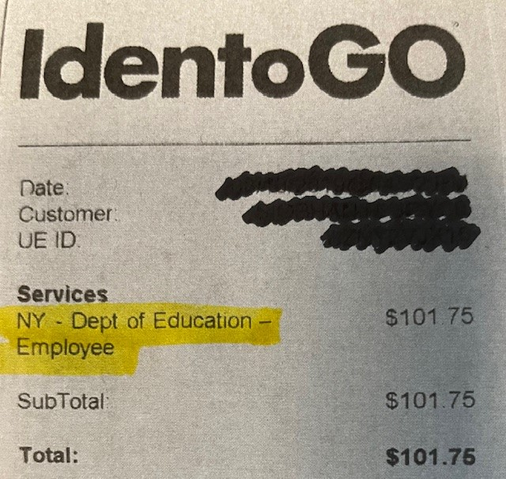
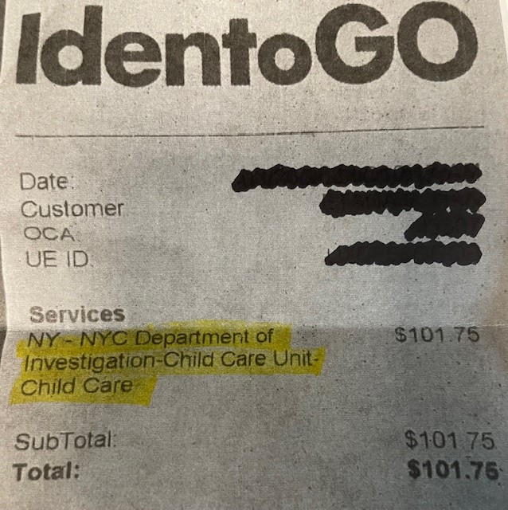
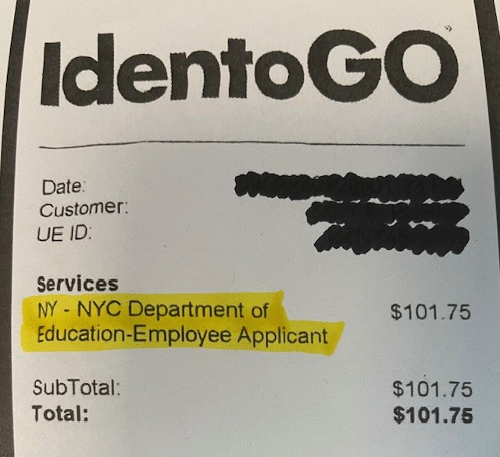
IdentoGo
IdentoGo provides fingerprinting services for many agencies, including both NY State and NYC Public Schools.
IdentoGo identifies which agency you are being fingerprinted for with a service code, used when making your appointment. Students must be careful to use the code for NYC Public Schools when making their fingerprinting appointment.
Your receipt will show you if you have been fingerprinted by the correct agency. Please see the examples below.

Slide 6
Clearance Transferability
Can transfer with OSPRA 104 Form
NYC Public Schools clearance
NY State clearance
Does not
transfer
NY State clearance
NYC Public Schools clearance
*Students with only NY State clearance will be required to be re-fingerprinted by NYC Public Schools

Slide 7
Assistance with Fingerprinting
For information on Queens College’s fingerprinting policy visit: https://www.qc.cuny.edu/academics/se/fingerprinting-policies-procedures/
Music, TESOL, Physical Education, & FCS majors
Email: victoria.dellera@qc.cuny.edu
SEYS majors
Email:
seysplacement@qc.cuny.edu
EECE majors
Email:
eeceplacement@qc.cuny.edu

Slide 8
Thank you!
If you have any questions not addressed in this presentation, please email the appropriate field placement coordinator for your program/major.

