Slide 1
Welcome to Queens College!
Congratulations on your acceptance!
Spring 2025 New Transfer Student Online Advising Presentation
This activity precedes your individual
virtual advising session with an academic advisor

Slide 2
Online Advising Presentation
Goals & Objectives
Academic Advising at Queens College ─ A Shared Model
Overview of your Queens College Bachelor’s Degree
Academic Policies & Procedures
Resources for Queens College Students
"Must have" Electronic Accounts
– CAMS, CUNYfirst”, QMail (Office 365) and QC Navigate
How to Prepare for your advising session

Slide 3
Academic Advising at Queens College
A Shared Model
Your Academic Advisor
in the Academic Advising Center
General Education & Overall Degree Requirements
Major exploration, requirements, and educational planning
College Policies & Procedures
Information about Curricular & Co-curricular Opportunities
Referrals to Academic & Campus Resources
Your Faculty Advisor
in the Respective Academic Department
Detailed understanding of the Academic Discipline
Departmental Policies & Procedures
Course Content, Requirements, and Expectations
Career & Academic Discussions
Undergraduate Research & Graduate Study Goals

Slide 4
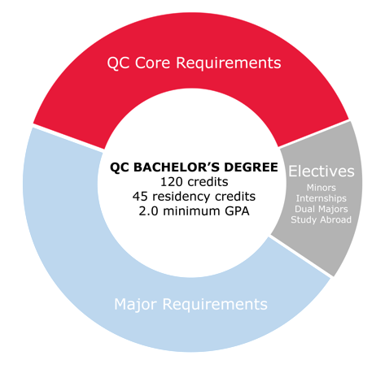
Your QC Bachelor’s Degree
An Overview

Slide 5
Your QC Bachelor’s Degree:
The Required Core
QC Core Requirements (CUNY Pathways)
Cannot use Pass/No Credit Grading Option for any courses applying to QC Core Requirements.
Courses can be found:
Academic Advising Degree Requirements
Pathways - General Education at Queens College

Slide 6
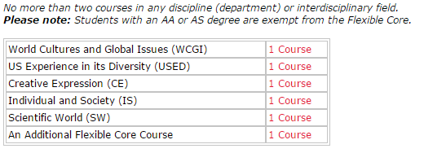
Your QC Bachelor’s Degree
The Flexible Core
QC Core Requirements (CUNY Pathways)
Cannot use Pass/No Credit Grading Option for any courses applying to QC Core requirements.
Courses can be found:
Academic Advising Degree Requirements
Pathways - General Education at Queens College

Slide 7
Your QC Bachelor’s Degree
The College Option
QC Core Requirements (CUNY Pathways)
Cannot use Pass/No Credit Grading Option for any courses applying to QC Core requirements.
Courses can be found:
Academic Advising Degree Requirements
Pathways - General Education at Queens College

Slide 8
Your QC Bachelor’s Degree
Writing Intensive Requirement
QC Core Requirements (CUNY Pathways)
Cannot use Pass/No Credit Grading Option for any courses applying to QC Core requirements.
Students must complete two Writing-Intensive "W" courses.
At least one "W" must be completed in residency at QC.
English 110 is a prerequisite for all "W" courses.
“W” courses can overlap with QC Core requirements or, if available, major and/or minor requirements. Discuss with an advisor.
Courses can be found:
Academic Advising Degree Requirements
Pathways - General Education at Queens College

Slide 9
Your QC Bachelor’s Degree Already have your AA or AS Degree?
If you have earned an Associate of Arts Degree (AA) or Associate of Science Degree (AS) from any U.S. institution, you are considered to have met the following requirements:
Required Core
Flexible Core
College Option Science
Additional College Option
To fulfill your remaining General Education requirements, you only need Literature, Language and one Writing Intensive Unit, which can be fulfilled by taking a Literature course with a “W” following the course number (example: Comparative Literature 101W) OR a “W” course in your major or minor (if available).
Please note that these exemptions do not apply to AAS and AOS degree holders.

Slide 10
Your QC Bachelor’s Degree
The Major
QC Major Requirements
Cannot use Pass/No Credit Grading Option for any courses applying to Pathways.
Majors vary in the number of credits and courses required.
At Queens College, the total number of credits in a major can range from 31 credits to 79 credits.
Some majors have entrance requirements and/or an application process.
Most majors have maintenance and graduation criteria.
See Academic Program Maps on Advising Center’s website.
Visit departmental websites for more information.

Slide 11
Your QC Bachelor’s Degree
Electives
QC Electives
If you transfer in 75 or fewer credits, you must reach at least 120 credits (minimum 45 credits in residency).
If you transfer in 76 or more credits, you must complete a minimum of 45 credits in residency and will need to exceed 120 credits.
If your transfer credits, plus your remaining QC Core and remaining major requirements do not add up to 120 credits (with 45 credits in residency), elective credits are needed.
Consider an internship, minor, or study abroad as options!

Slide 12
Your QC Bachelor’s Degree
Declaring Your Major
When you speak with your academic advisor, you will learn the process for declaring the particular major in which you are interested.
Please note that you must declare your major by your 60th completed credit. This is required by CUNY and Financial Aid.
The Spring 2025 deadline is Friday, January 31, 2025.
Students who have completed 60 or more transfer credits who do not declare their majors by the deadline are in jeopardy of losing their NYS TAP award.

Slide 13
Your QC Bachelor’s Degree Majors with entrance criteria
The Queens College programs listed below have entrance criteria, pre-requisites, and/or application requirements. If you are not yet ready to apply, advisors will discuss options with you.
Aaron Copland School of Music
BFA in Studio Art
Business Administration (Corporate Finance, International Business, or Actuarial Studies)
Communication Sciences and Disorders (Speech Pathology)
Drama,Theatre & Dance
Elementary/Childhood Education
Neuroscience
Nutrition and Dietetics
Secondary Education

Slide 14
Your QC Bachelor’s Degree
Transfer Honors Program
The Queens College Transfer Honors Program is for highly motivated students like you!
​ Scholarships ranging from $1,000 to full-tuition per semester for up to two years.
Small honors classes that emphasize discussion and group projects.
Dedicated academic advisors who support your transition to QC and provide assistance
in identifying mentors, applying for awards, and preparing for graduate study or career
placement.
Priority consideration to competitive majors and honors programs.
Priority registration.
Preferred consideration for on-campus housing.
To be eligible, you must have a minimum cumulative GPA of 3.5+ and at least 60 credits
upon entry to Queens College. Receipt of Associate Degree Preferred.
For more information contact:
Office of Honors & Scholarships
Transferhonors@qc.cuny.edu

Slide 15
Your QC Bachelor’s Degree
Honors Minors
Honors in the Math and Natural Sciences
A 12-credit program to enhance the undergraduate education of students interested in careers in the mathematical and natural sciences.
Director: Dr. Uri Samuni
Uri.Samuni@qc.cuny.edu
Honors in the Humanities
An 18-credit minor designed for students who wish to explore and understand the origins and history of our contemporary artistic and intellectual culture. (24 credit Sequence in the Humanities)
Director: Dr. Clare Carroll
Clare.Carroll@qc.cuny.edu
Honors in the Social Sciences
A 21-credit minor that encourages students to gain an in-depth understanding of social science traditions and methods.
Director: Dr. Thomas Ort
Thomas.Ort@qc.cuny.edu​
Honors in Business and Liberal Arts (BALA)
A 24-credit minor designed to teach students in all academic disciplines the business skills necessary to succeed in today’s fast paced global economy.
Director: Schiro Withanachchi
BALA.Department@qc.cuny.edu

Slide 16
Graduate With Honors!
General College Honors
Requires a minimum 3.5 GPA.
Keep In Mind: Most graduate schools accept a minimum of 3.0 GPA
Complete a minimum of 45 residency credits in QC
Pass/No Credit (P/NC) grades are not counted towards the 45 residency credits
For details on how your honors GPA is calculated (which includes transfer plus QC coursework), please see the Office of Honors & Scholarships.
Departmental Honors
Check with academic department(s) for specific requirements
College Honors​
Cum Laude (3.5-3.749)
Magna Cum Laude (3.75-3.899)
Summa Cum Laude (3.9-4.0)
For more information contact:
Office of Honors & Scholarships
qc _honors@qc.cuny.edu |718-997-5502

Slide 17
Your QC Bachelor’s Degree
Residency Requirements Reminder!
Remember:
120 credit minimum if you are transferring in 75 or fewer
credits.
At least 45 credits must be done in residency at Queens College
for transfers with 76 or more transfer credits.
Minimum of one Writing Intensive course in residency.
Your major {and minor} at Queens might have additional
residency requirements. Consult with your faculty advisor.

Slide 18
Your QC Bachelor’s Degree
Stay on Track “Take 15”

Slide 19
Your QC Bachelor’s Degree
Get a Head Start with Winter and Summer Classes!
New transfers may get a head start with Winter 2025 classes!
Summer & Winter Sessions are a great way to make progress toward your degree and stay in compliance with NYS TAP (and other Financial Aid) and the NYS Excelsior Scholarship!
2025 Winter Session Dates
Take up to a maximum of 4 credits
January 2 to January 24
2025 Summer Session Dates
See link below for dates for Summer 2025!
CUNY’s Winter and Summer 2025 course offerings will be conducted online, in person and in hybrid format.
See CUNYfirst for mode of instruction.
For session information, please refer to the Winter Session or Summer Session webpages.
For tuition information, please refer to the Bursar webpage.
To speak to an advisor about Winter 2025, fill out the Winter Interest form.

Slide 20
Academic Policies & Procedures
Complete Your Transfer File
Submit final transcripts and score reports to the Undergraduate Admissions Office. Visit the website for information on virtual document submission of:
Advanced Placement (AP) – see how your scores will transfer
Advanced International Certificate of Education Program (AICE)
College Level Examination Program (CLEP)
Defense Language Proficiency Tests (DLPT)
International Baccalaureate (IB)
For comprehensive information on transferring credits through Industry Credentials, Portfolio Assessment, DSST Credit by Examination Program and Military Training and Occupations please see the CUNY – Credit for Prior Learning website.
CUNY College Now courses and credits (but not grades)
will automatically be applied to your QC record.
Undergraduate Admissions Office Admissions@qc.cuny.edu
Jefferson Hall, Room 105 │ 718-997-5600

Slide 21
Academic Policies & Procedures
Decisions that Affect Your Financial Aid
NYS Aid (TAP) prohibits repeating a course for which you have received transfer credits & an acceptable grade.
Full time credits required each semester (ideally 15 credits per semester, minimum 12 per semester)
Courses must apply towards your declared major, minor, General Education requirements, or necessary electives as applicable.
Do not repeat courses taken previously. Discuss with an advisor and check your credit evaluation.
Last day to add Fall 2023 course(s) for Financial Aid Certification – Friday, January 31, 2025.
Major declaration deadline – Friday, January 31, 2025.
Maintain acceptable GPA (min. of 2.0) & demonstrate “Satisfactory Academic Progress" (SAP).
When in doubt, ask an advisor!
*If major requires entrance criteria/an application please consult with an advisor.

Slide 22
Resources for Queens College Students NYS Excelsior Scholarship
The Excelsior Scholarship, in combination with other student financial aid programs, allows students to attend a CUNY college tuition–free.
In order to apply, students must meet eligibility requirements, including:
Be residents of New York State
Plan to attend a CUNY or SUNY college or university in pursuit of a two-year or four-year degree
Have a family federal adjusted gross income of $125,000 or less
Be on track to graduate on time with an Associate’s Degree in two consecutive years or a Bachelor’s Degree in four consecutive years
Please visit www.hesc.ny.gov/excelsior for more information.
Note: To apply for the Excelsior Scholarship you will need to complete the 2019 - 2020 FAFSA and TAP application.
APPLY TODAY!!! (See HESC website for details and deadline)

Slide 23
Academic Policies & Procedures
Course Permit Process
Permit = taking coursework post-transfer outside of Queens College toward your QC degree
General Rules:
Prior approval from QC is required
Must have an established GPA of at least 2.0 (C average)
Within CUNY System (called an “ePermit”)
Done electronically: apply for ePermit via CUNYFirst. Both ROTC students and first-semester
transfer students are eligible to apply for an “ePermit” in their first semester. Eligibility is
based on previous college GPA.
Grades earned on ePermit (including failing grades) are included on your academic record
Outside of CUNY (called a “Non-CUNY Permit”)
Paper permit used: form available on the Registrar’s website
Must obtain faculty signature and submit form to QC Hub via a Fresh Service Ticket.
Visit the QC HUB webpage for more information.

Slide 24
The Billing Process
Once you are registered for courses, your tuition bill will be generated. You will receive an email to your QC email account (Office 365) informing you of the bill due date, which is based on your initial date of registration.
Please note: Tuition Bills are not mailed to your home.
View your tuition bill and applied Financial Aid in your Self-Service/Student Service Center page on CUNYfirst.
You are held financially and academically responsible once you are registered for classes. Should your intention change to attend QC, you must drop your classes. Non-payment will not drop your classes.
Late fees will be assessed when adding/swapping courses after the semester has begun.
For payment due dates, liability schedule and payment options,
please visit the Bursar Website.
Notes:
24

Slide 25
QC Technology: Accounts & Access
All students entering Queens College must claim their “QC Username” account through the College’s “CAMS” system. This allows for access to campus computers, Wi-Fi on campus, obtaining your college ID card, as well as other college web-based applications.
Register for classes, view and pay your tuition bill, check final grades, sign-up for CUNY Alert, use Blackboard, Degree Works, e-Permit, as well as other services.
Your Queens College Student Email Account, aka Qmail”. This account is used for all official college correspondence.
Note: Same Username and Password at CUNYfirst.
Download the QC Navigate App. Schedule an online/virtual appointment with an advisor, see an up-to-date class schedule and your appointment, connect to resources and MUCH MORE!
Information Technology – Help Desk
Helpdesk@qc.cuny.edu Dining Hall, 151 │718-997-4444

Slide 26
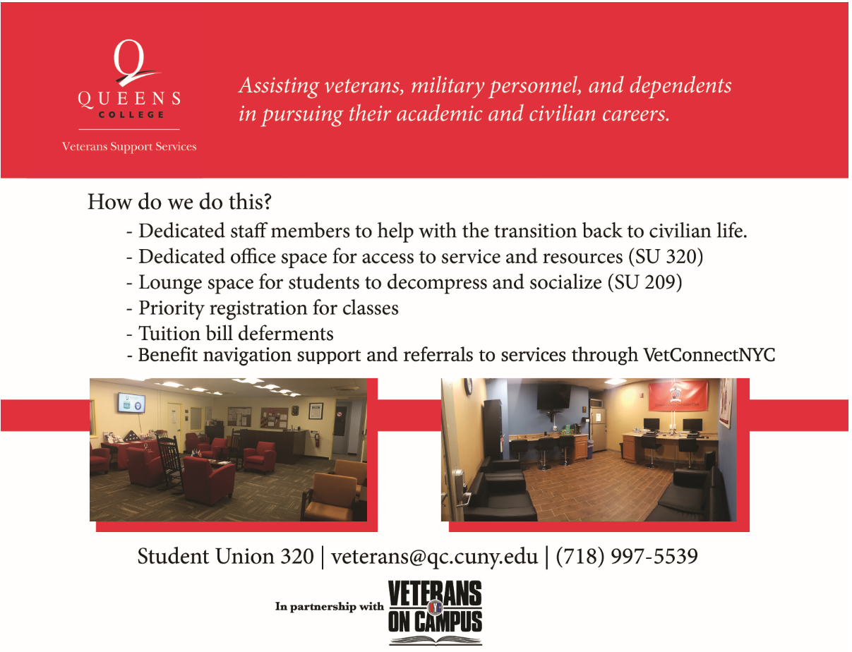
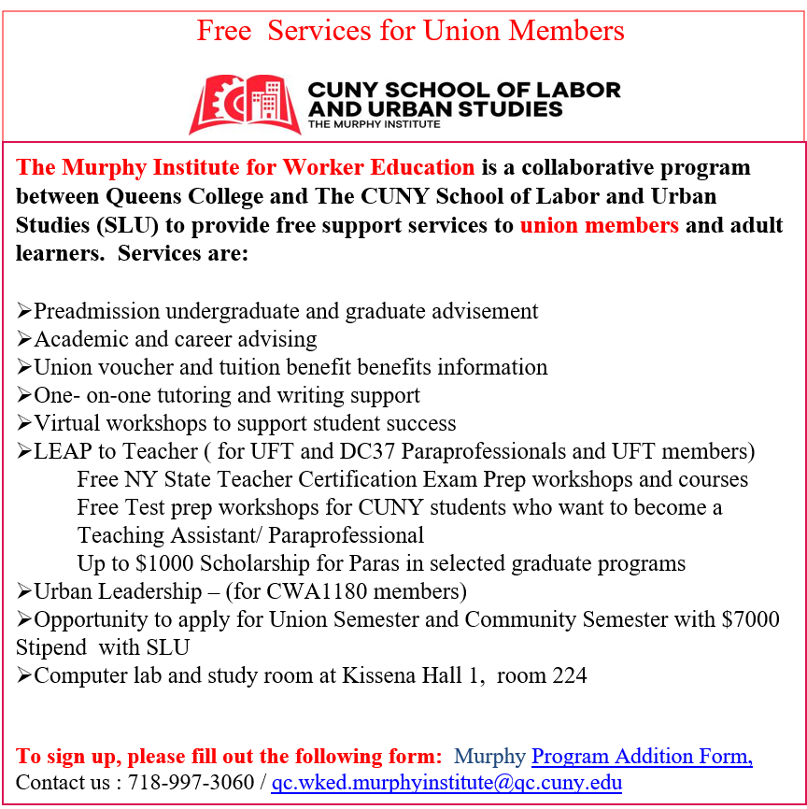
Resources for Queens College Students Veteran and Union Member Support Services

Slide 27
Next Steps
The next step in the enrollment process is to review and complete the 10 Steps Before Your Virtual Transfer Advising Session on the Transfer Advising webpage. You will learn about our academic offerings, degree options and campus resources.
Be prepared for your one-on-one virtual appointment with an academic advisor to create your first semester programming and begin discussion on your academic planning
If you have not received an Invitation to sign-up, please contact the New Student phone line at 718.997.5573 and leave a message. Someone will return your call promptly.
We are here to help make your transition to Queens College smooth and successful, and we look forward to meeting you.

